Slide 1
24MAT180
S2 P/M

Slide 2
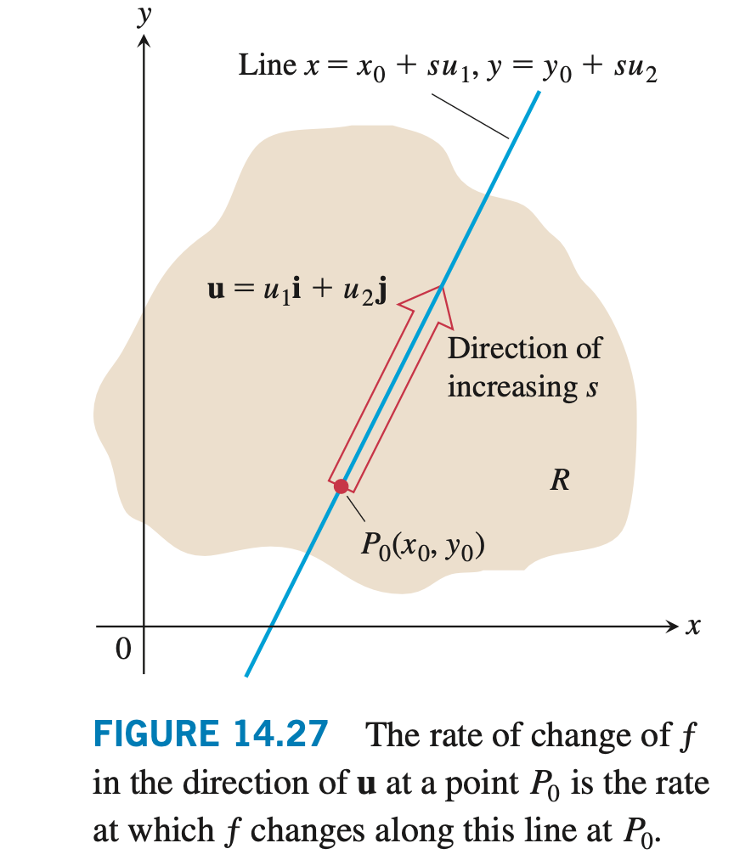

Slide 3


Slide 4
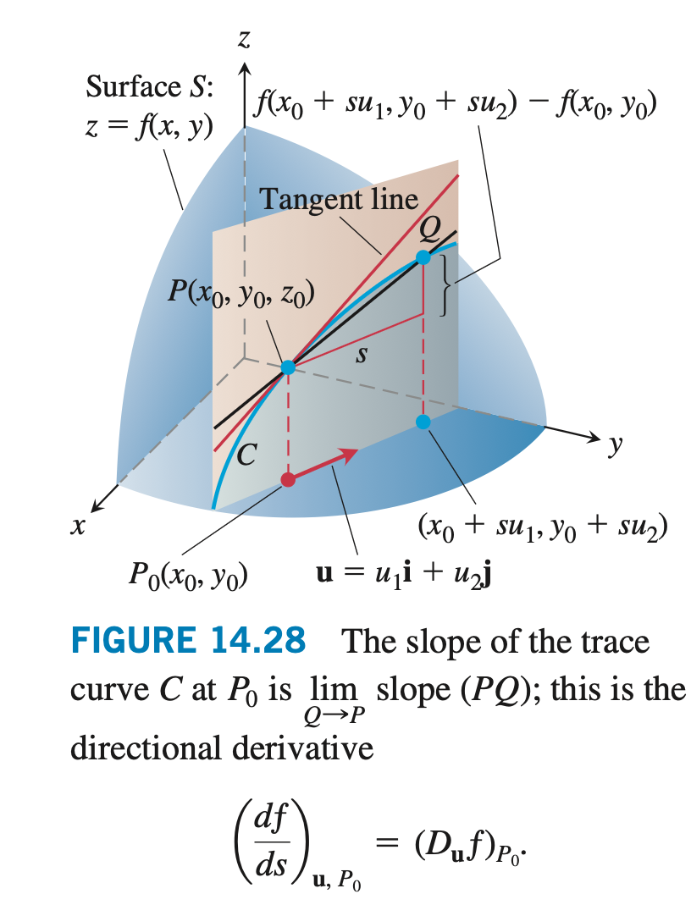

Slide 5


Slide 6


Slide 7


